Slide 1
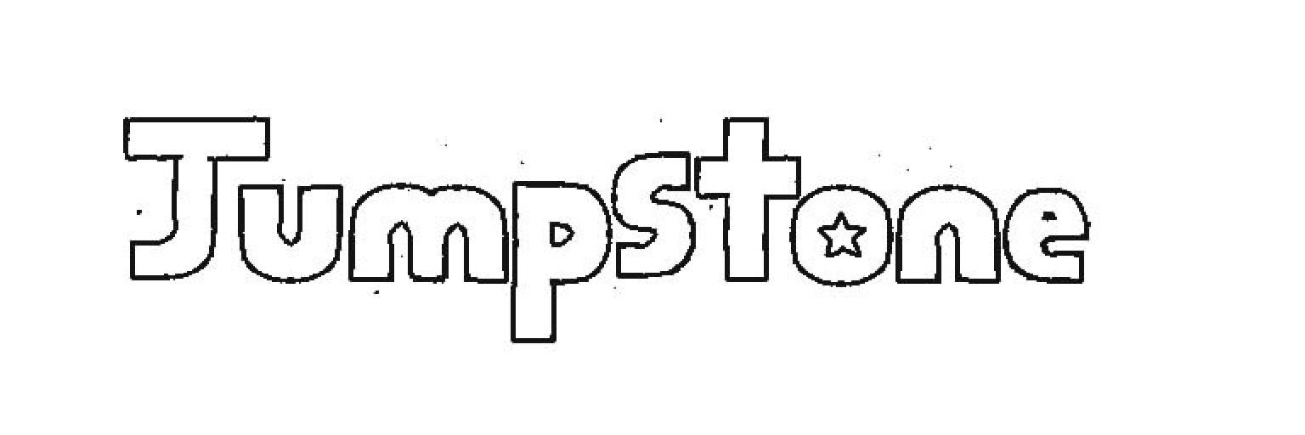
By: Peter C, Alex H, Aditya V

Slide 2
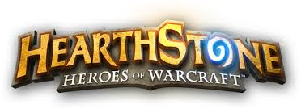
What we made
Our project was meant to be a parody of the well-known collectable card game Hearthstone that included Mario characters.
Our project consisted of creating an engine similar to what Hearthstone has and creating unique cards for it.

Slide 3

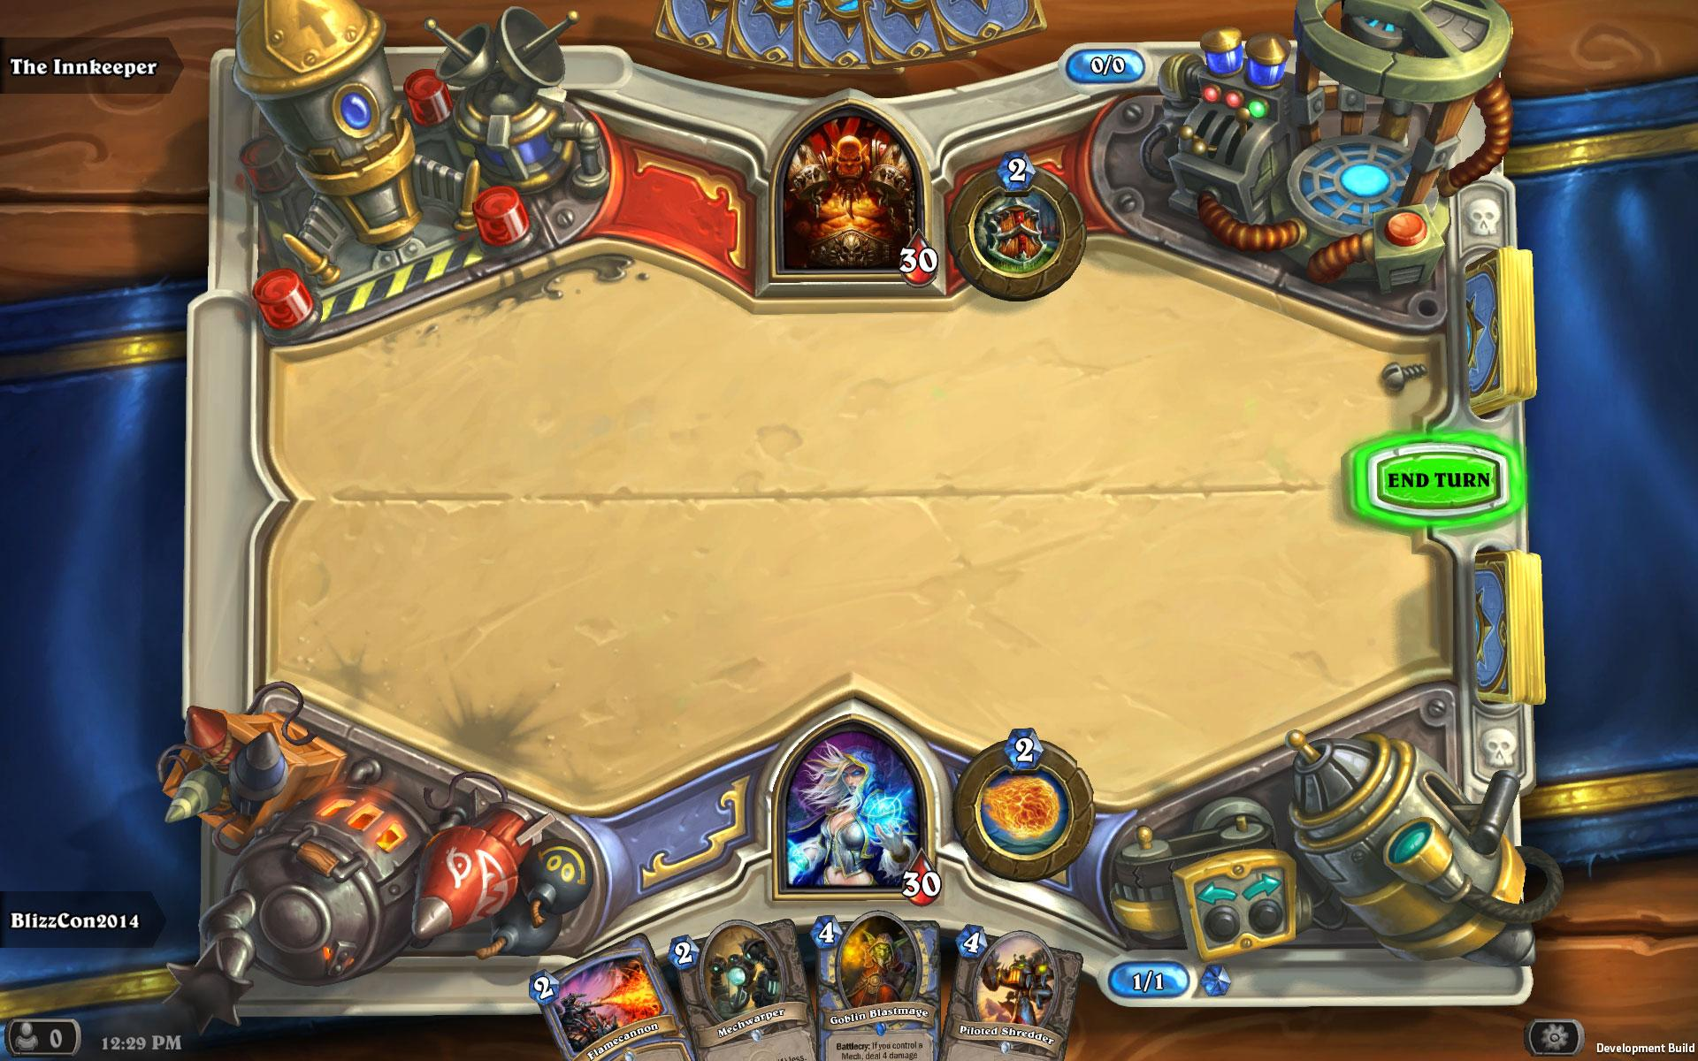
Roles
Alex Huang: Card Artist; Partial Coding
Peter Cardenas: Lead Coder
Aditya Venkat: UI Director

Slide 4
Structure
Functions were essential for turn-based gameplay
Accurate dimensions were vital for maintaining clean visuals
Total of eighty-four Cards
  Minions
  Spells

Slide 5
Difficulties
Organizing our functions
Solving problems created by an open-ended card game
Implementing cards efficiently
Indexing and calling upon a library of cards
Time management difficulties

Slide 6
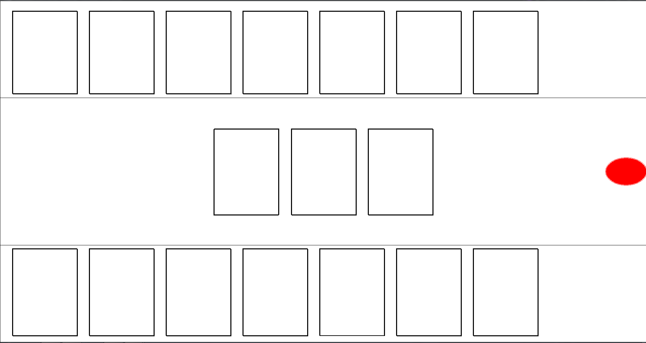
Expectations vs Reality
Due to time constraints and a lack of knowledge about coding we were unable to complete our vision of “Jumpstone”
What our board looks like:
Timer’s locations
Mulligan Phase: Starting phase when player picks and chooses cards
Playing field where minion sprite was supposed to be displayed
Your Hand During gameplay: Where cards would be placed before entering the field

Slide 7
Expectations vs. Reality (cont.)
As of now our game does not include clickable regions or moving objects; therefore, our game does not include any functionality
Expectations | Reality
We click on a “minion” and it would give off a sound effect | We managed to project the image of the minion
We would create a working timer | We have the position for the timer
We would create a working battle phase | Complexity of the board halted progress

Slide 8
Lessons Learned
Time management
Organization of code
Mass producing graphics
Cataloguing

